Slide 1
Decision Tree Machine Learning Model
By Amrita Panjwani

Slide 2
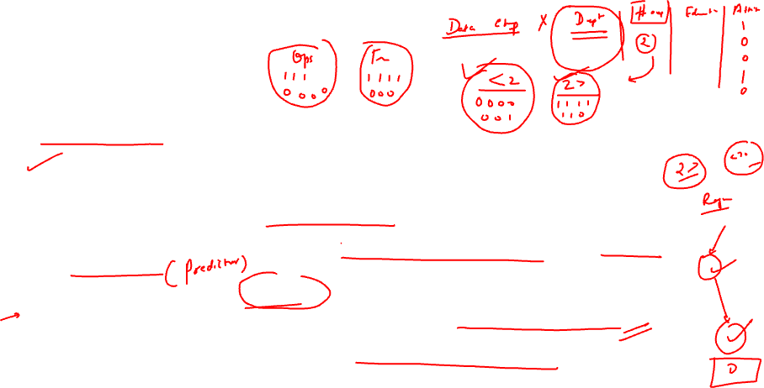
Definition
Decision Tree is a classification and regression supervised ML model. It can be used for a classification problem and also a regression problem.
But it is best suited for a classification problem
In a decision tree the dataset is split into different groups based on the features.
The aim is to use that feature for splitting which results in a purer group or in other words which results in a better classification.
Decision Tree Model is based on ‘recursive partitioning’.
There are different algorithms based on different splitting criteria.

Slide 3
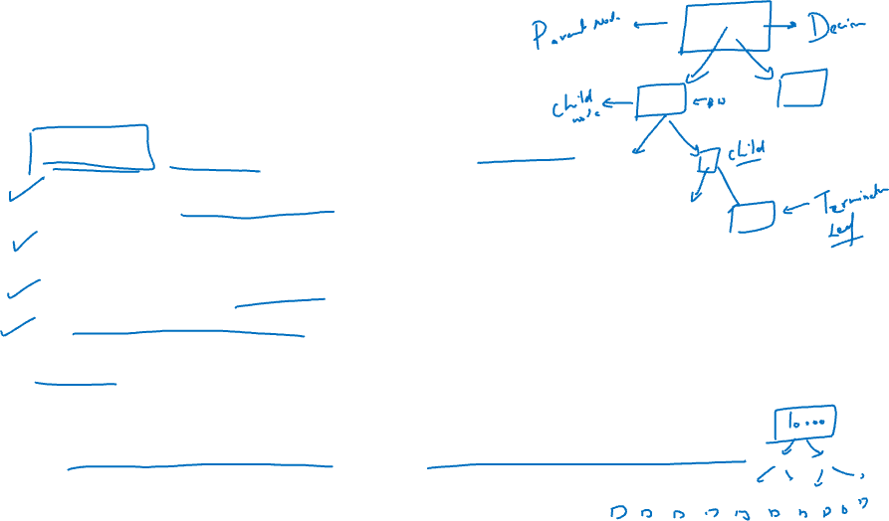
Basic Terminologies
Root Node: Main node ( from where the splitting starts)
Decision Node: A point where decision about splitting needs to be taken. It is also called ‘condition node’
Parent / Child Nodes: In a split the split nodes are called child node, and the node from where they split is called parent node.
Subnode: Same as child node
Terminal Node/ Leaf Node: Last node of the tree that does not get divided further.
Pruning: Once the decision tree is completed formed, it may be required to remove some of the splits and reshape the decision tree, this process is called pruning. It is completely opposite of splitting.
In splitting the tree size increases, in pruning the tree size decreases.

Slide 4
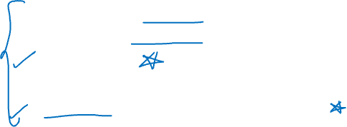
Constraints of tree splitting
A decision tree aims to obtain pure nodes. For this it may go on splitting till the time it gets 100% pure nodes. That is the reason it is also known as a ‘Greedy Algorithm’
Since we do not want the tree to continue splitting till the last pure node, we predefine some constraints on when to stop splitting on when should it proceed to split.
Minimum samples on a node to split
Minimum samples for a terminal node
Maximum depth
Maximum number of terminal nodes
Maximum features to be considered for a split

Slide 5
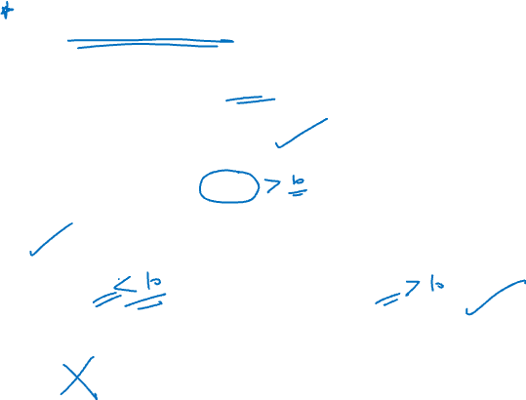
Minimum samples on a decision node to split
Lets say if the rule is that a node must have atleast 10 samples to go for further split
Root Node
(20)
Class
(7)
Class IX
Class X
Performance
(13)
> average
< average

Slide 6
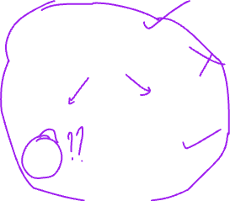
Minimum samples for a terminal node
Suppose if the rule is that minimum samples in the terminal or leaf node must be 5
Root Node
Class
Class IX
Class X
Performance
(13)
> Average
(4)
< average
(9)

Slide 7
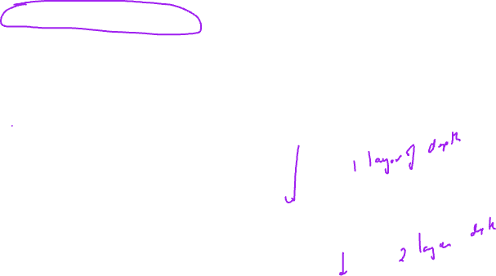
Maximum depth: Depth is defined as the number of vertical splits the tree needs to do in order to give the final prediction. We can limit this depth by specifying the maximum depth acceptable for pruning purpose.
Root Node
Class
Class IX
Class X
Performance
> average
< average

Slide 8
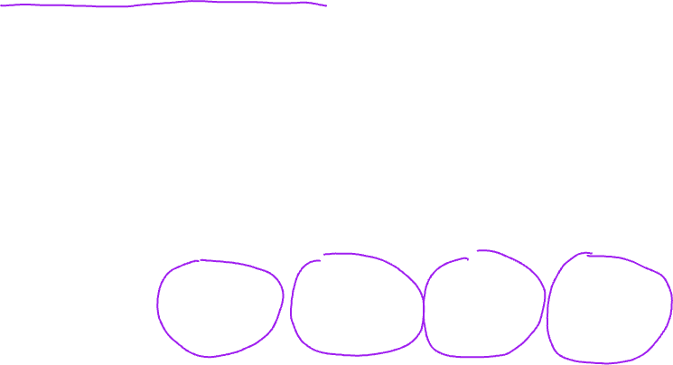
Maximum number of terminal nodes
Root Node
Class
Class IX
Class X
Performance
> average
< average

Slide 9
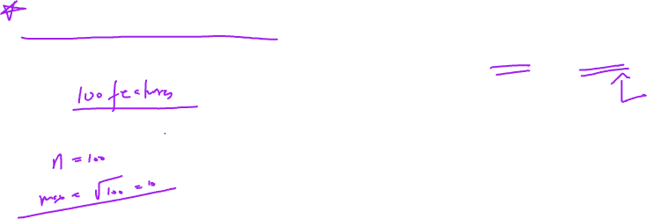
Maximum features to be split: Generally when there are n features in a dataset, the maximum features to be split is set to sqrt(n) or log(n)
Root Node
Class
Class IX
Class X
Performance
> average
< average

Slide 10
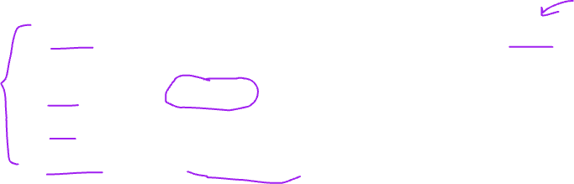
Different splitting algorithms
CART: Classification And Regression Tree. It uses GINI as splitting criteria
C4.5: It uses Entropy as splitting criteria
ID3: It uses Entropy as splitting criteria
CHAID: It uses CHI SQUARE as splitting criteria
99% of the time CART will be used in all DT models.

Slide 11
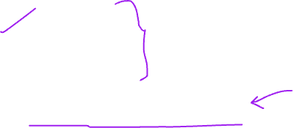
Four splitting methods are as follows:
GINI
ENTROPY
CHI- SQUARE
REDUCTION IN VARIANCE

Slide 12
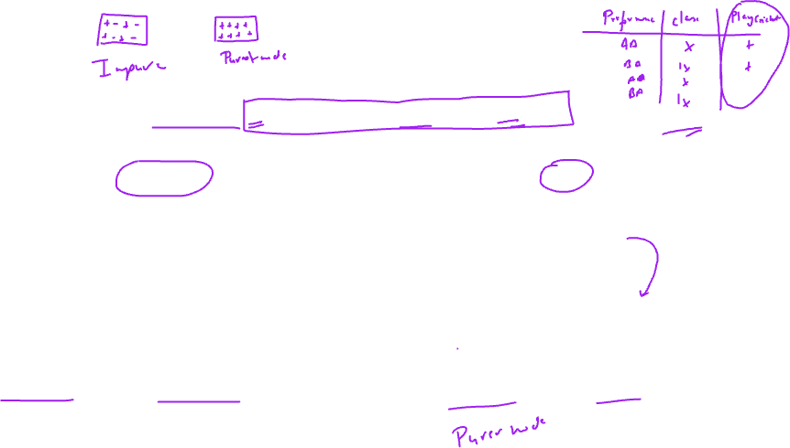
Example
Let the decision node have 20 students. + denotes those who play cricket and – denotes those who do not play cricket
Split by performance
Split by class
+ + + + + + + + + + - - - - - - - - - -
+ - + - - + + - + - + + + -
- - - + + -
+ + + + + + + + + + - - - - - - - - - -
+ + + + + + - - + +
- - - - + - + - - -
Above Average
Below Average
Class IX
Class X

Slide 13
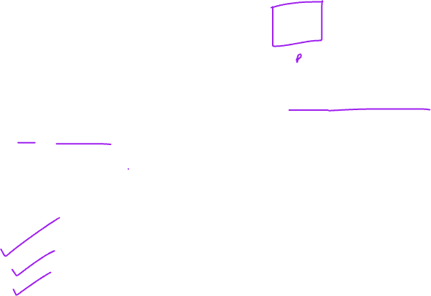
GINI
GINI is a measure that talks about purity of a node.
Steps of calculation:
1. Calculate GINI for each subnode
2. Calculate GINI Impurity of each subnode
3. Calculate the overall weight GINI impurity of the split.

Slide 14
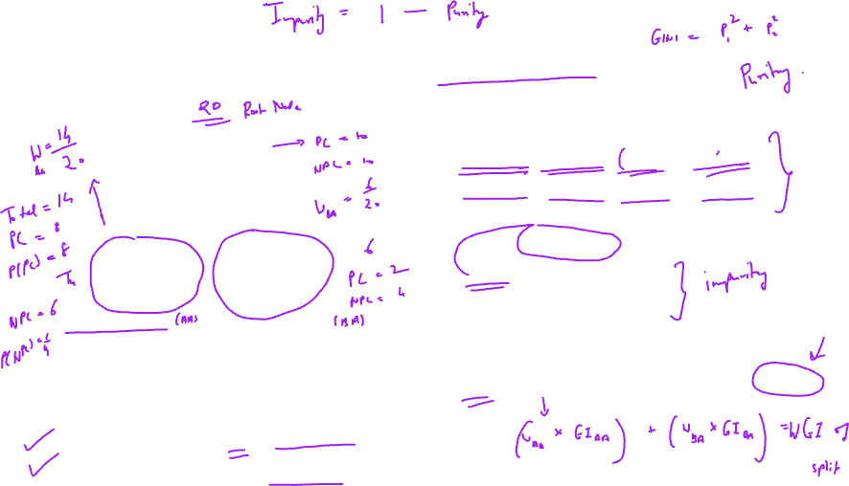
GINI Calculation for split by performance
+ + + + + + + + + + - - - - - - - - - -
+ - + - - + + - + - + + + -
- - - + + -
Step I: GINI calculation of each sub node
GINI (AA) = (0.57)^2 + 0.43)^2 = 0.5098
GINI (BA) = (0.33)^2 + (0.67)^2 = 0.5578
Step II: GINI Impurity calculation for each sub node
GI(AA) = 1 – 0.5098 = 0.4902
GI(BA) = 1 – 0.5578 = 0.4422
Step III: Weight GI of entire split
WGI = (14/20)*0.4902 + (6/20) * 0.4422 = 0.4758
Above Average
Below Average
Total = 14
Play cricket = 8
Not play cricket = 6
P(+) = 8/14 = 0.57
P(-) = 6/14 = 0.43
Total = 6
Play cricket = 2
Not play cricket = 4
P(+) = 2/6 = 0.33
P(-) = 4/6 = 0.67

Slide 15
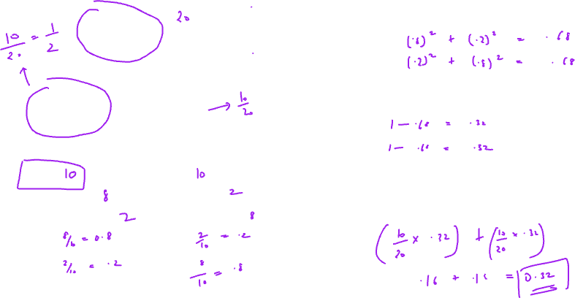
GINI Calculation for split by class
+ + + + + + + + + + - - - - - - - - - -
+ + + + + + - - + +
- - - - + - + - - -
Step I: GINI calculation of each sub node
GINI (IX) =
GINI (X) =
Step II: GINI Impurity calculation for each sub node
GI(IX) =
GI(X) =
Step III: Weight GI of entire split
WGI = (W class IX) * GI(IX) + (W class X) * GI(X)
WGI =
Class IX
Class X
Total =
Play cricket =
Not play cricket =
P(+) =
P(-) =
Total =
Play cricket =
Not play cricket =
P(+) =
P(-) =

Slide 16
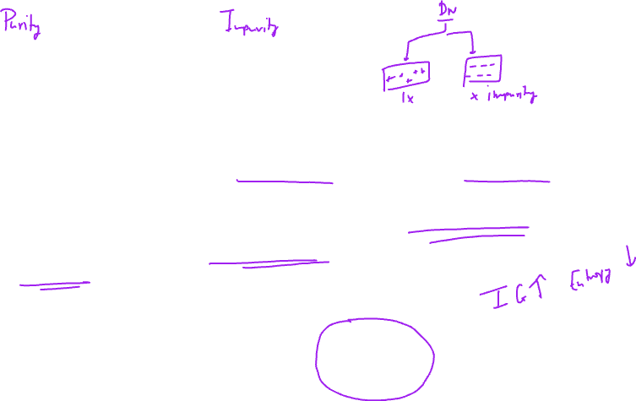
Information gain/Entropy
Entropy can be defined as degree of randomness. If there is high randomness in a node, it is less pure.
On the other hand, if there is more information gain, nodes of higher purity can be obtained.
When we move from parent node to child node there is information gain.
Hence information gain leads to higher purity nodes hence reducing their randomness (Entropy)
Pure Node
Impure Node
+ + + + + + + + + + + + + +
+ - + - + - + - + - + - + - + -

Slide 17
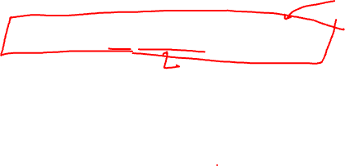
Steps to calculate Entropy
Step 1: Calculate Entropy of each subnode
(Note: the log is to the base 2)
Use this link for it: https://www.omnicalculator.com/math/log-2
Step 2: Calculate Weighted Entropy of the entire split

Slide 18
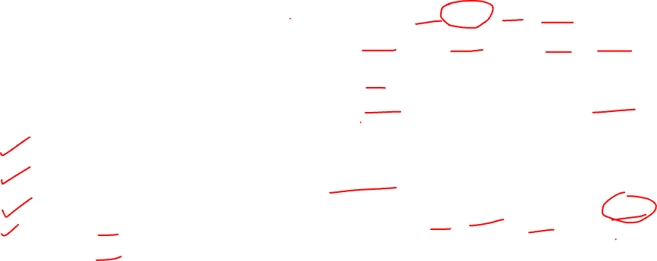
Entropy Calculation for split by performance
+ + + + + + + + + + - - - - - - - - - -
+ - + - - + + - + - + + + -
- - - + + -
Step I: ENTROPY calculation of each sub node
Step II: Weighted Entropy of entire split
Above Average
Below Average
Total = 14
Play cricket = 8
Not play cricket = 6
P(+) = 8/14 = 0.57
P(-) = 6/14 = 0.43
Total = 6
Play cricket = 2
Not play cricket = 4
P(+) = 2/6 = 0.33
P(-) = 4/6 = 0.67

Slide 19
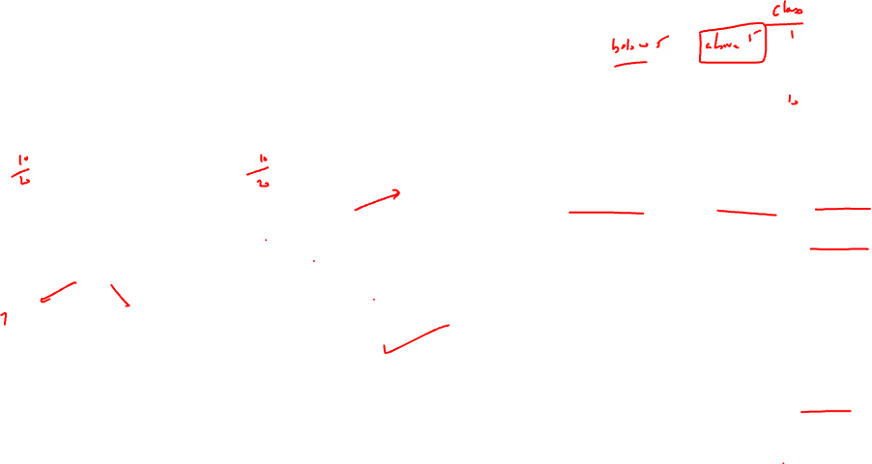
Entropy Calculation for split by class
+ + + + + + + + + + - - - - - - - - - -
+ + + + + + - - + +
- - - - + - + - - -
Step I: ENTROPY calculation of each sub node
Step II: Weighted Entropy of entire split
Class IX
Class X
Total = 10
Play cricket = 8
Not play cricket = 2
P(+) = 0.8
P(-) = 0.2
Total = 10
Play cricket = 2
Not play cricket = 8
P(+) = 0.2
P(-) = 0.8

Slide 20
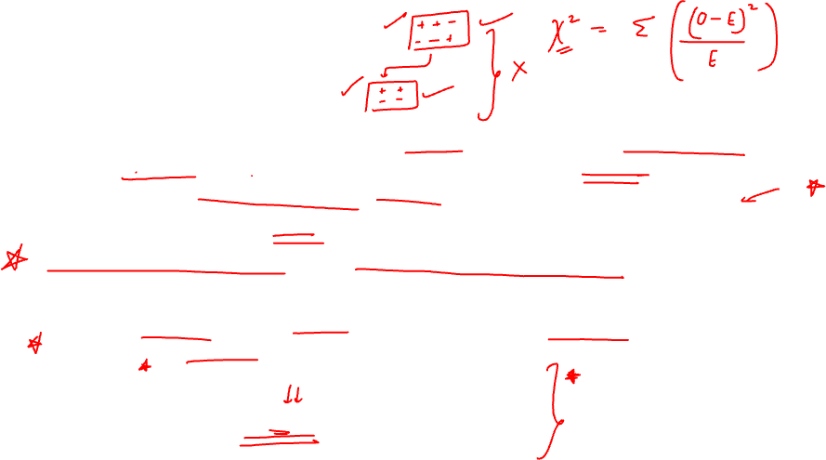
Chi square Method
This method aims to find the statistical significance between the parent nodes and the subnodes. It is measured by the sum of squares of differences between the observed and expected frequencies.
It generates a tree called CHAID ( Chi – square Automatic Interaction Detector)
Higher the value of Chi square , higher is the homogeneity. (Purity)
[So far in GINI impurity and Entropy we were looking for lower values, now we look for higher Chi square values]

Slide 21
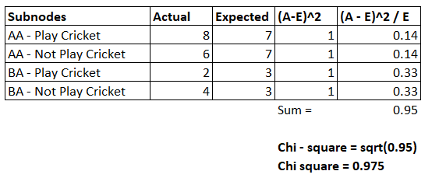
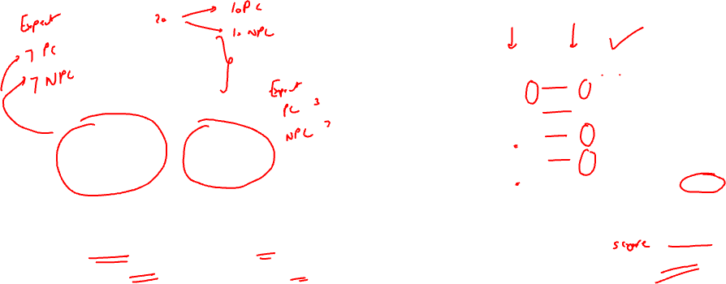
Chi- square Calculation for split by performance
+ + + + + + + + + + - - - - - - - - - -
+ - + - - + + - + - + + + -
- - - + + -
Above Average
Below Average
Total = 14
Play cricket = 8
Not play cricket = 6
P(+) = 8/14 = 0.57
P(-) = 6/14 = 0.43
Total = 6
Play cricket = 2
Not play cricket = 4
P(+) = 2/6 = 0.33
P(-) = 4/6 = 0.67

Slide 22
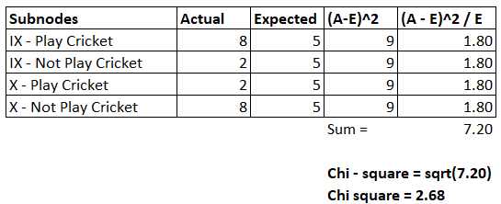
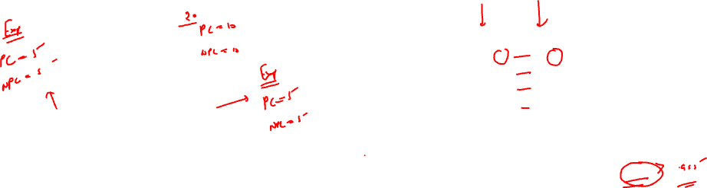
Chi-square Calculation for split by class
+ + + + + + + + + + - - - - - - - - - -
+ + + + + + - - + +
- - - - + - + - - -
Class IX
Class X
Total = 10
Play cricket = 8
Not play cricket = 2
P(+) = 0.8
P(-) = 0.2
Total = 10
Play cricket = 2
Not play cricket = 8
P(+) = 0.2
P(-) = 0.8

Slide 23
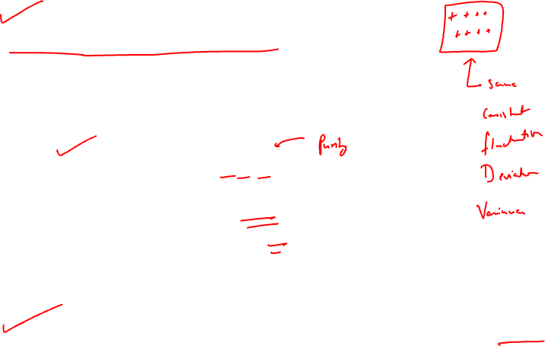
Reduction in Variance
The aim is to reduce the variance in the subnodes.
Variance for first node is : 4.3
Variance for second node is: 0
It can be seen that second node is pure.
Hence a reduction in variance indicates higher purity of node.
2, 6 , 5
6 , 6 , 6

Slide 24
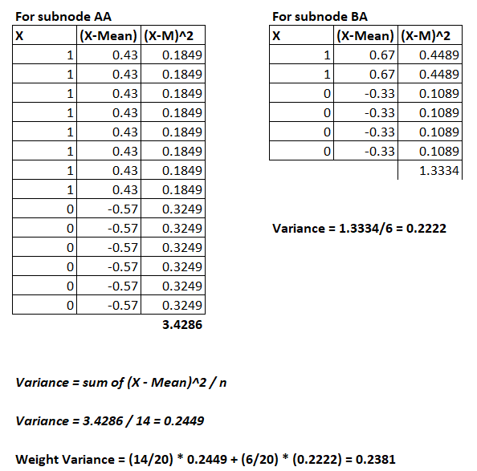
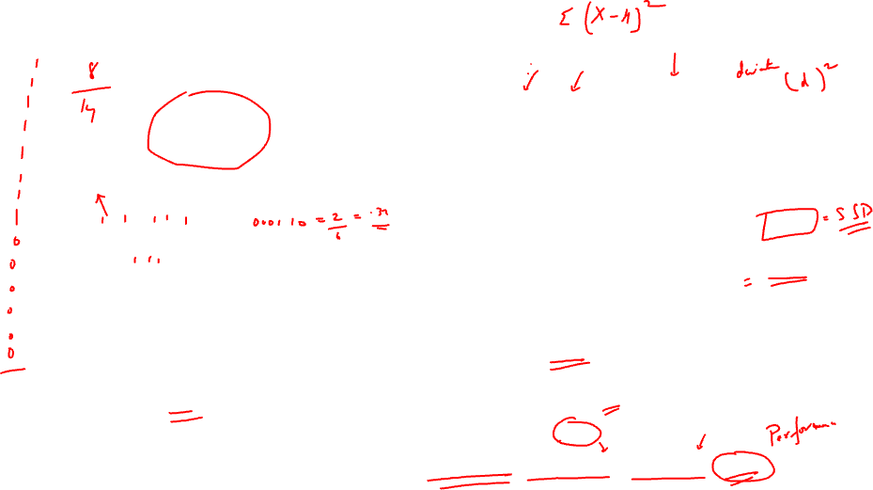
Variance Calculation for split by performance
+ + + + + + + + + + - - - - - - - - - -
+ - + - - + + - + - + + + -
- - - + + -
Above Average
Below Average
Total = 14
Play cricket = 8
Not play cricket = 6
Mean = 8/14 = 0.57
Total = 6
Play cricket = 2
Not play cricket = 4
Mean = 2/6 = 0.33

Slide 25
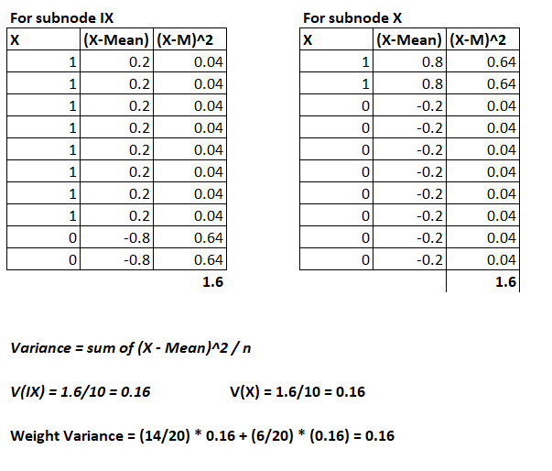
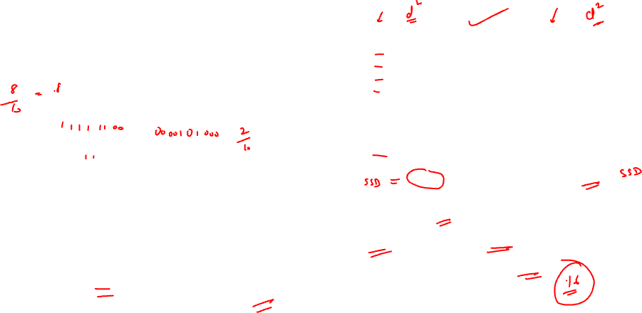
Variance Calculation for split by class
+ + + + + + + + + + - - - - - - - - - -
+ + + + + + - - + +
- - - - + - + - - -
Class IX
Class X
Total = 10
Play cricket = 8
Not play cricket = 2
Mean
= 8*(1) + 2*(0)/10 = 0.8
Total = 10
Play cricket = 2
Not play cricket = 8
Mean
= (2*(1)+8*(0))/10 = 0.2

